Slide 1

Graph Neural Networks Clustering
By- Gaurav Kumar Rai

Slide 2
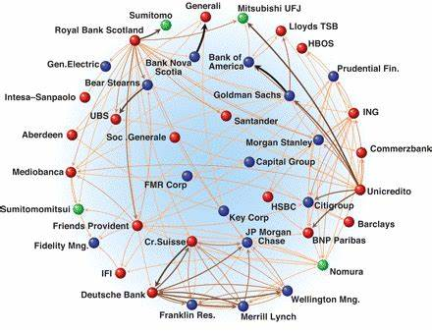
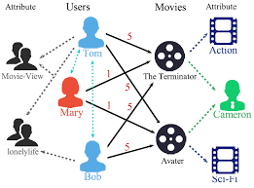
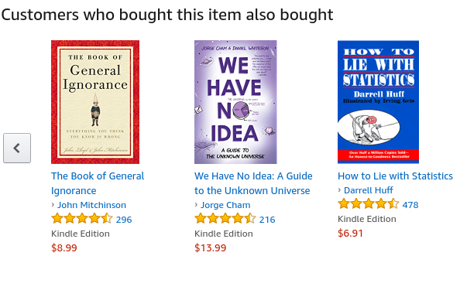
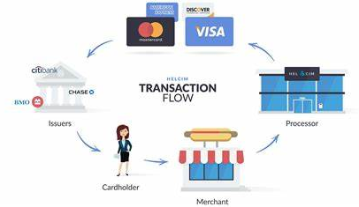
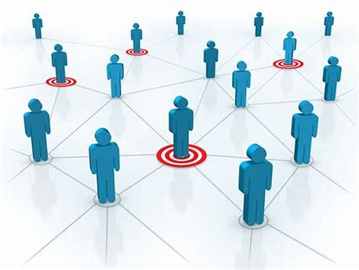
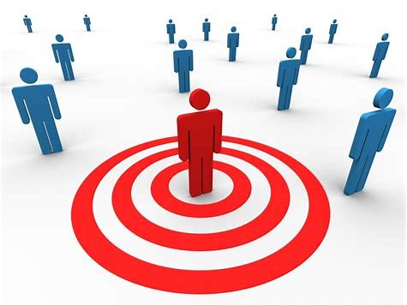
Fraud & Abuse
Recommendations
Detect malicious accounts, fraudulent financial transactions, fake reviews, fraudulent insurance claims, …
Products, media, articles, experiences, jobs, courses, spouses, …
Financial transactions network
Collaborative knowledge graph
Marketing
Who should get a discount? Who are the influencers? Who are the risk of churning?
Social network
Notes:
Graphs are present in many of these applications.

Slide 3
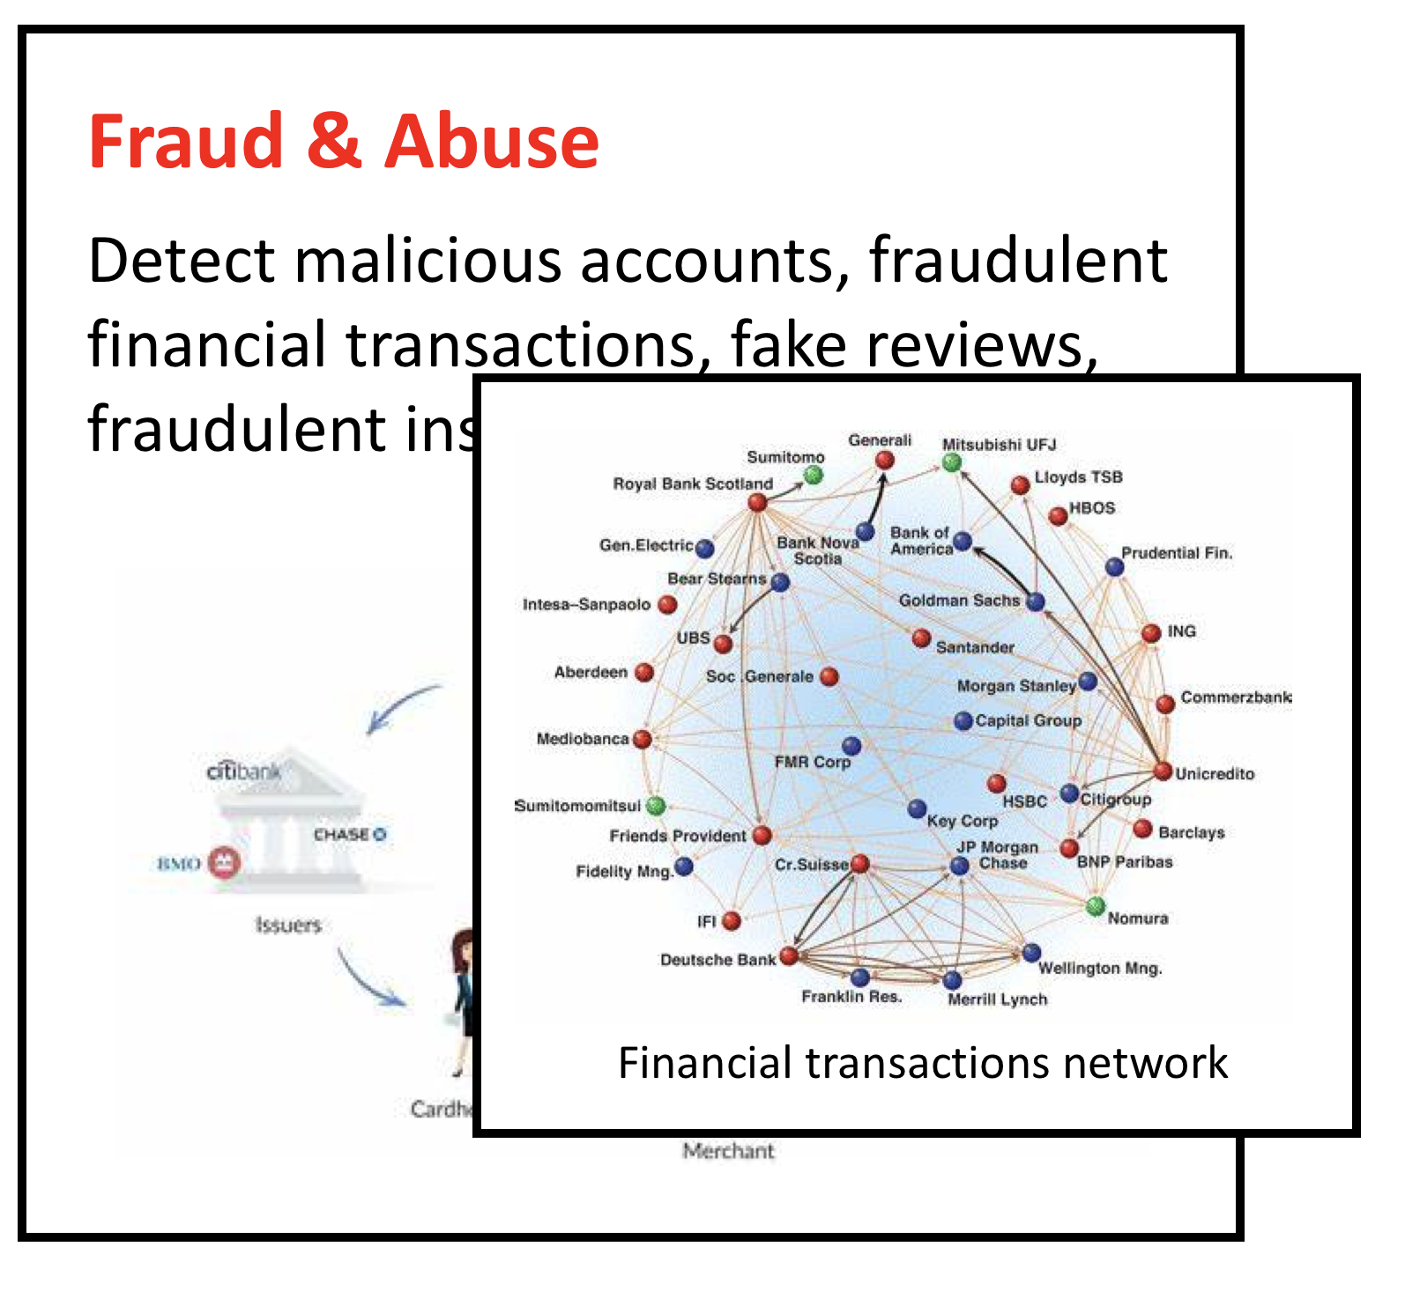
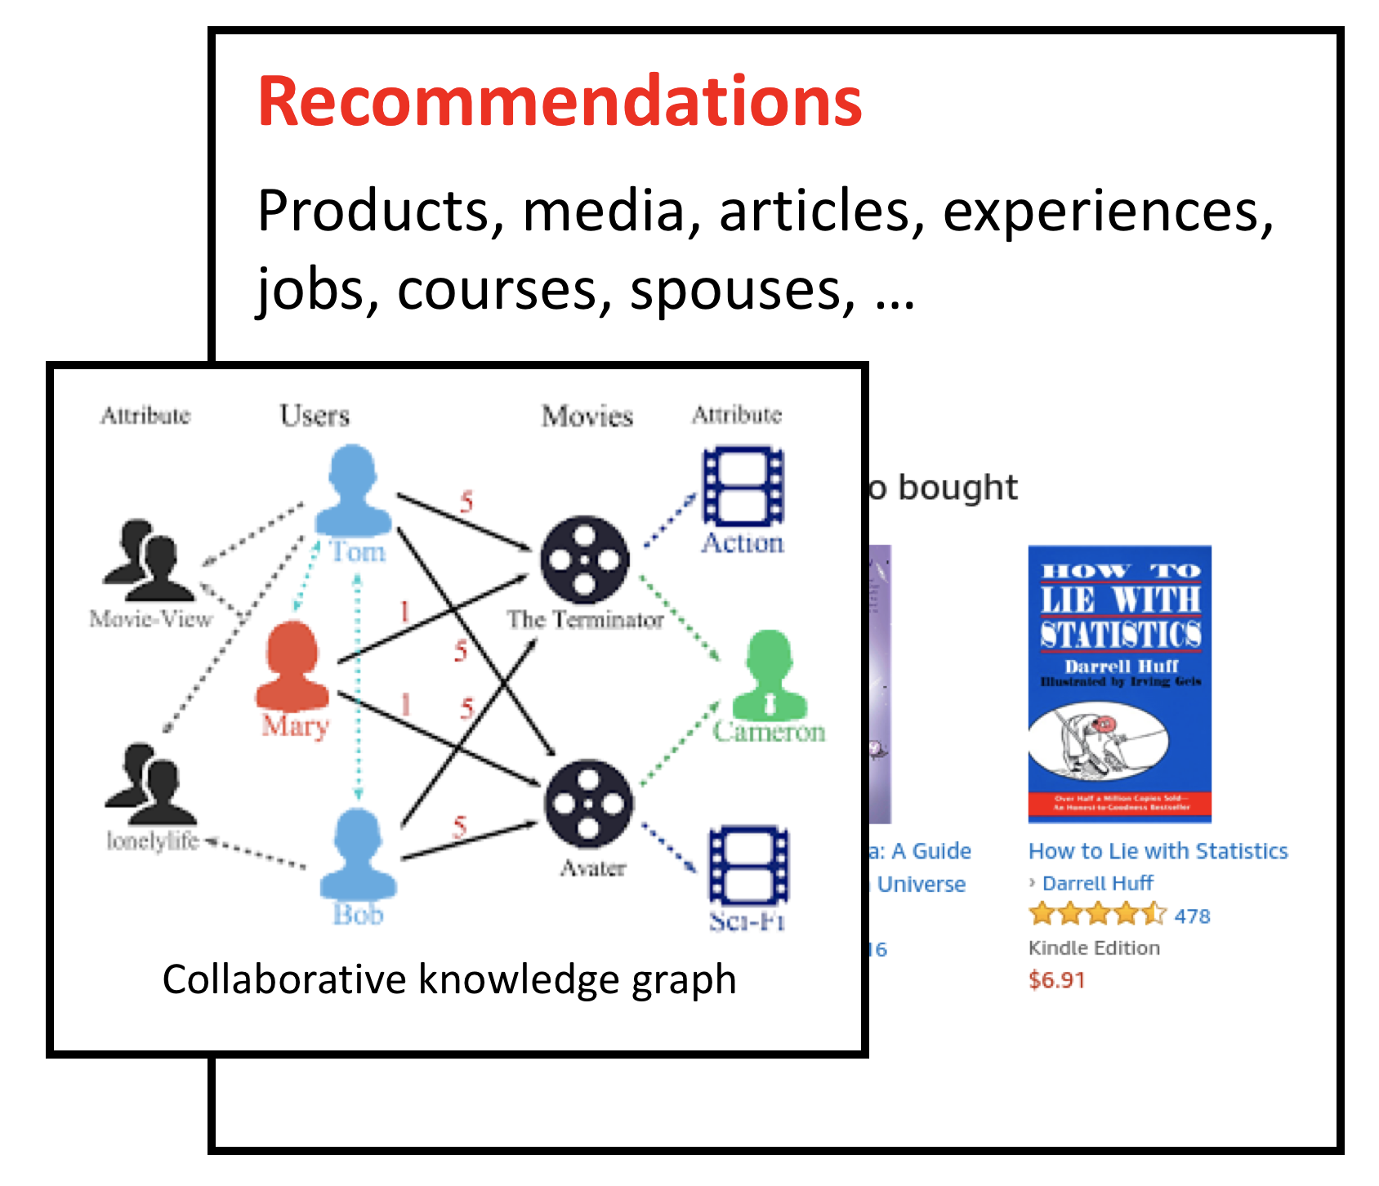
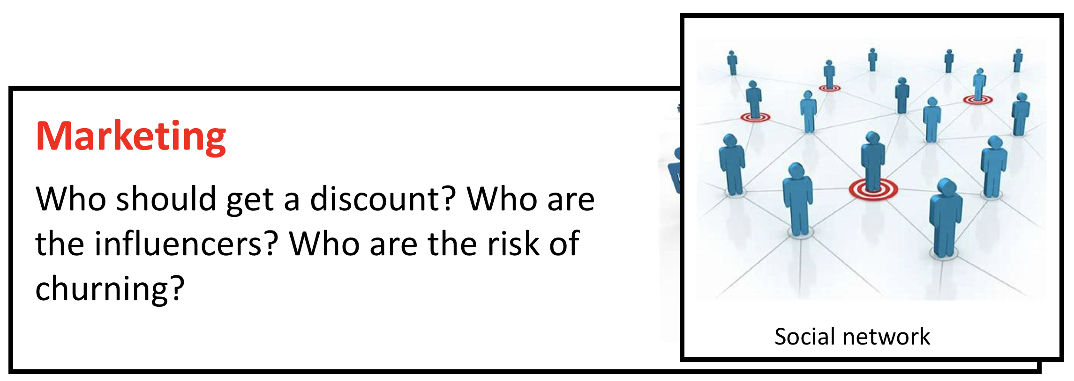
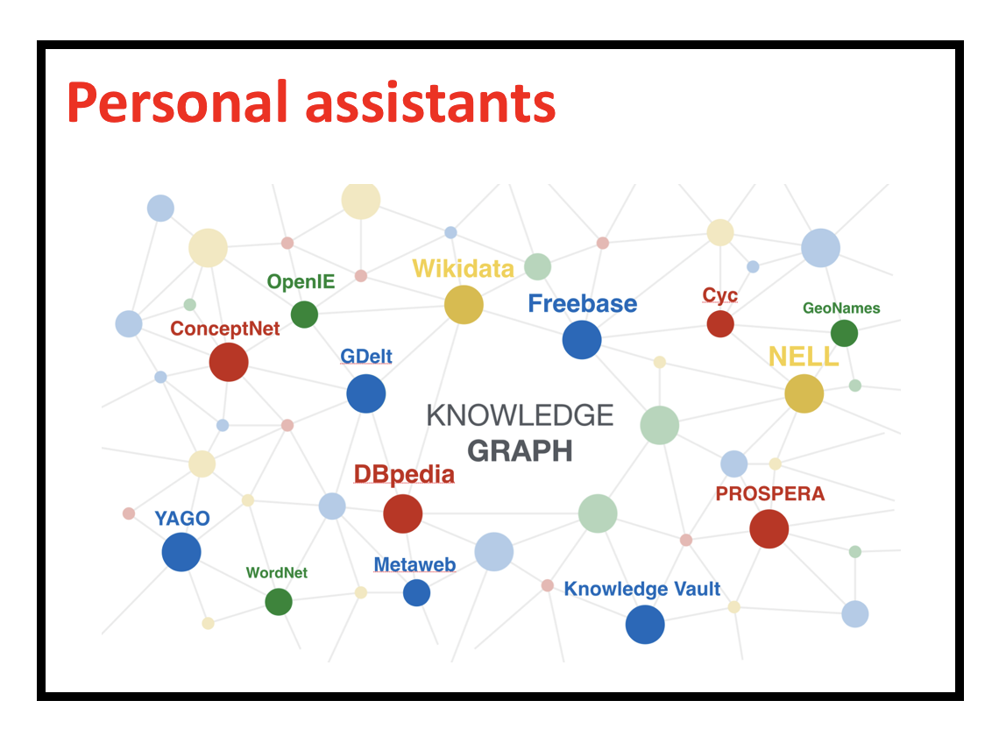
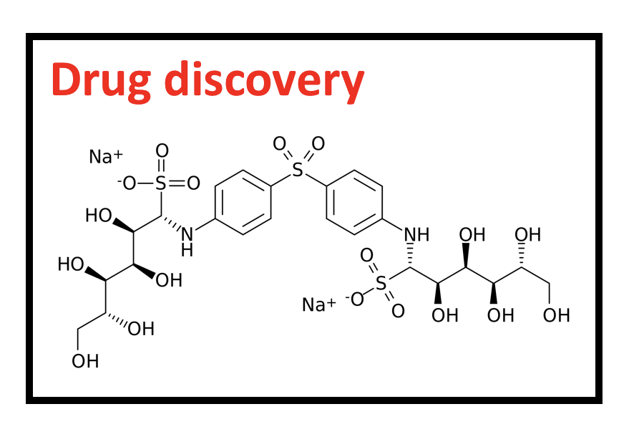
Tasks in graph learning
Node classification
Detect malicious accounts
Target right customers
Link prediction
Recommendations
Predict missing relations in a knowledge graph
Graph classification
Predict the property of a chemical compound

Slide 4
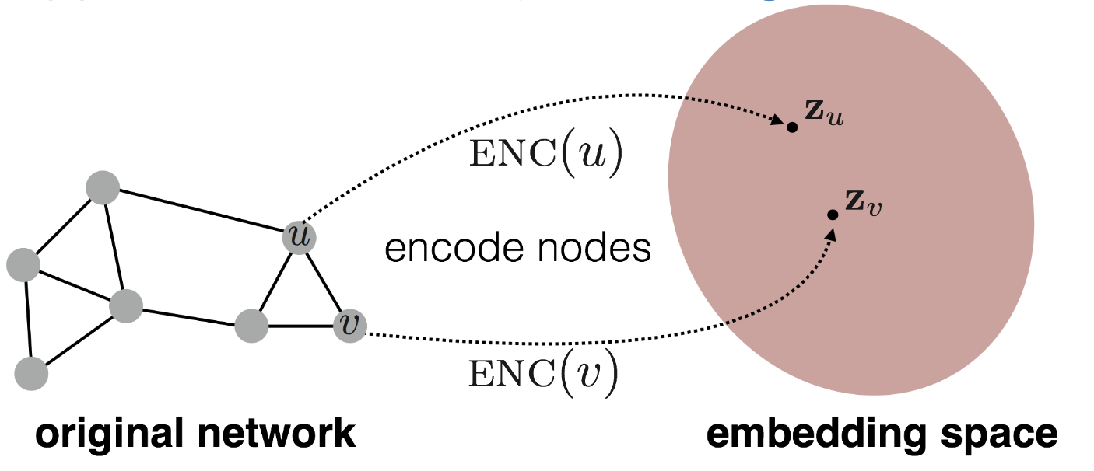
Graph learning and node embeddings
Embed nodes to a low-dimension space so that these embeddings capture the essential task-specific information and use them to train off-the-self classifiers.
For example, node similarities in the embedding space approximates the similarities in the original graph.

Slide 5
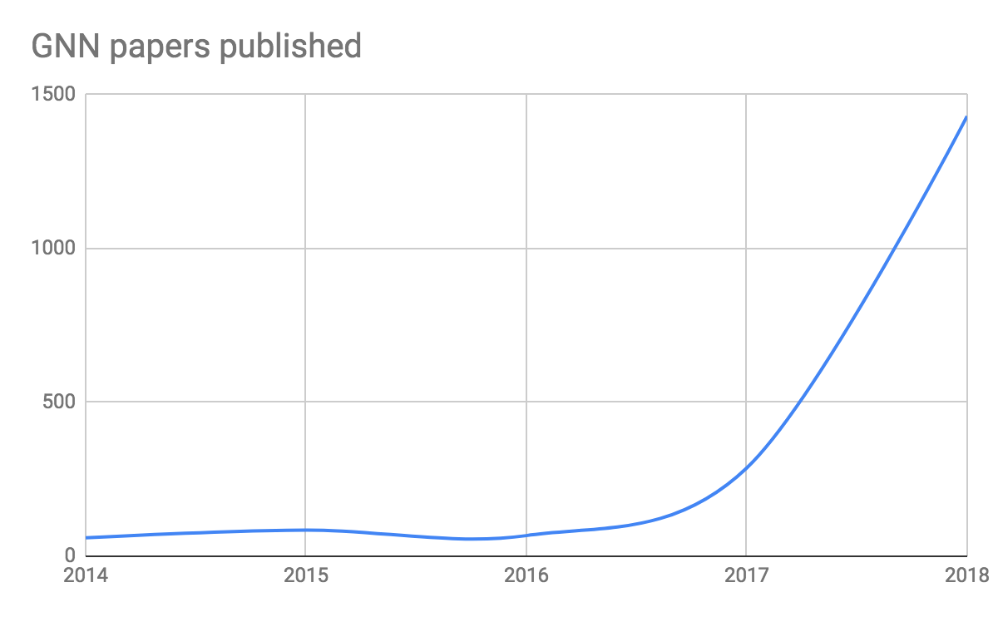
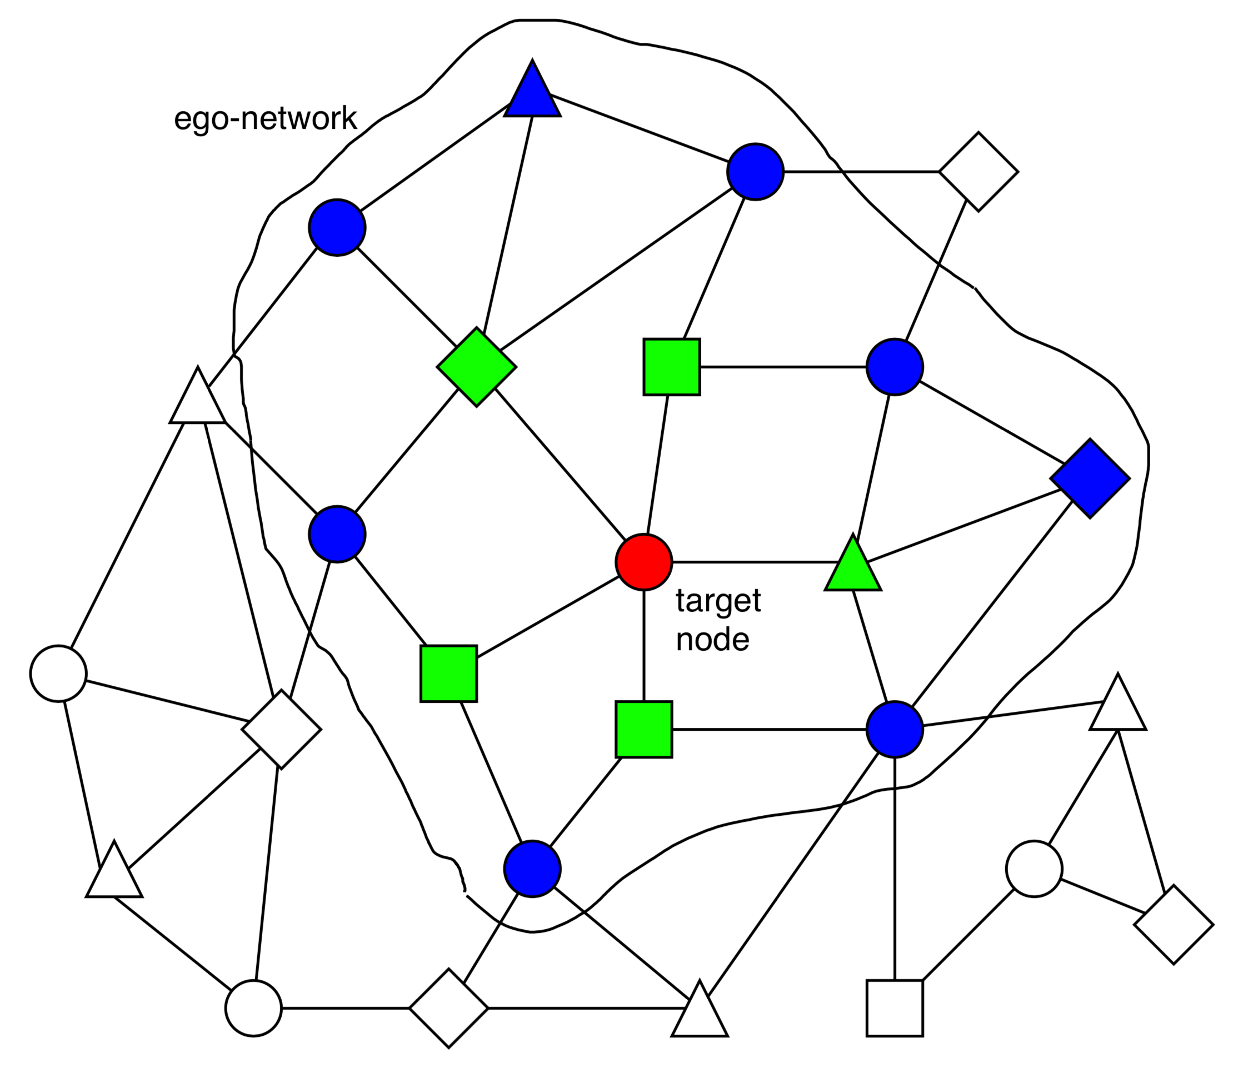
GNN gaining Popularity
They are becoming extremely popular.
Graph Neural Network (GNN)
A family of (deep) neural networks that learn node, edge, and graph embeddings.
How do GNNs work?
An ego-network around each node is used to learn an embedding that captures task-specific information.
The embeddings use both the structure of the graph and the features of the nodes and edges.
The embeddings are learned in an end-to-end fashion; thus, the predictions are a function of the target node’s ego-network.

Slide 6
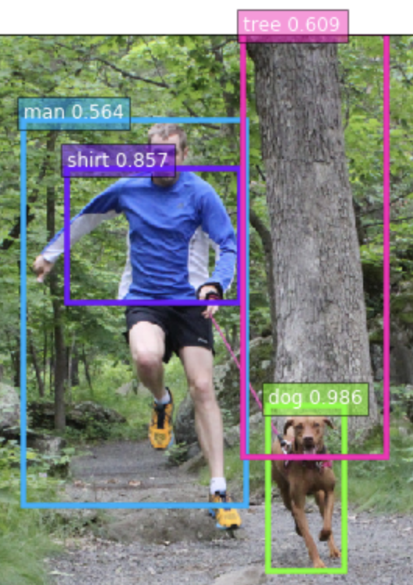
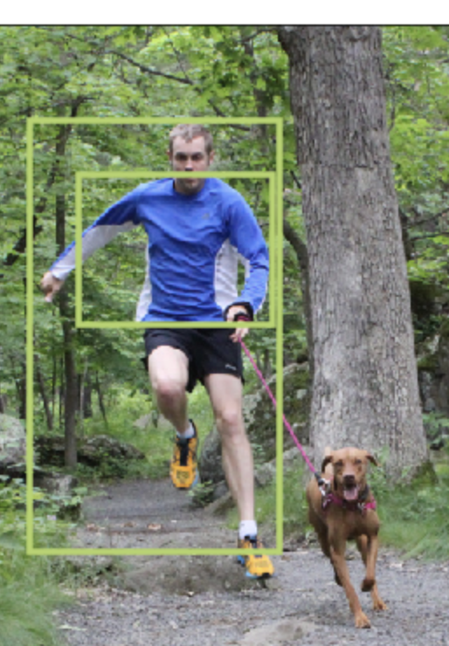
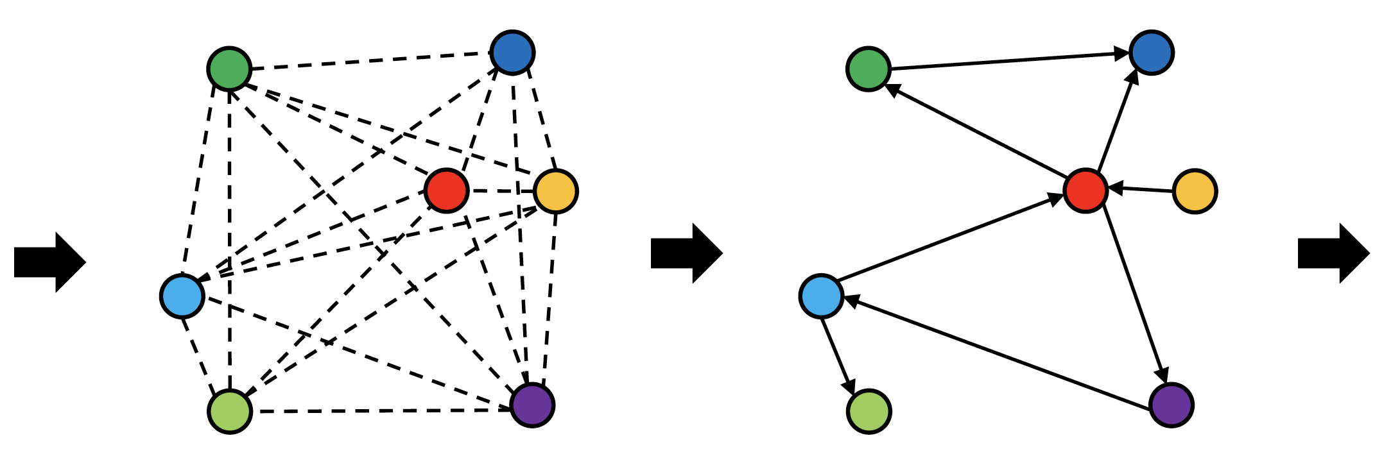
Scene graph extraction
Scene Graph Generation
Link exists with prob 68.99%
Link type:
<man> <have> <shirt>, 43.29%
<man> <wear> <shirt>, 39.64%
GCN
Object Detection
Notes:
Our model can be trained in less than one hour as it converges to produce good results. This example also shows the possible ambiguity of relationships, and how the model deals with it.

Slide 7
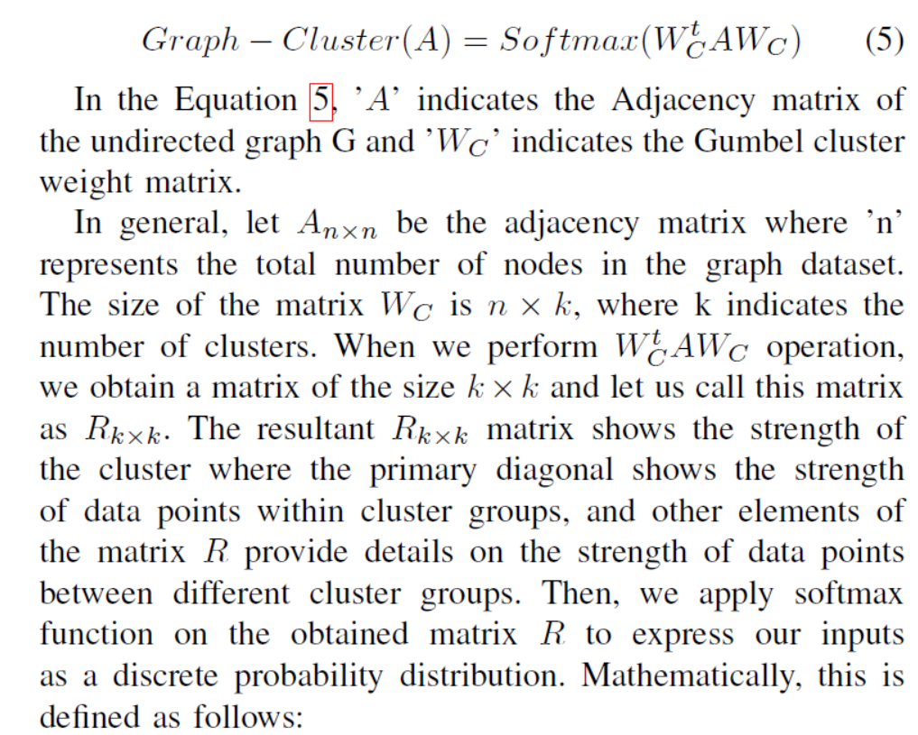

Slide 8
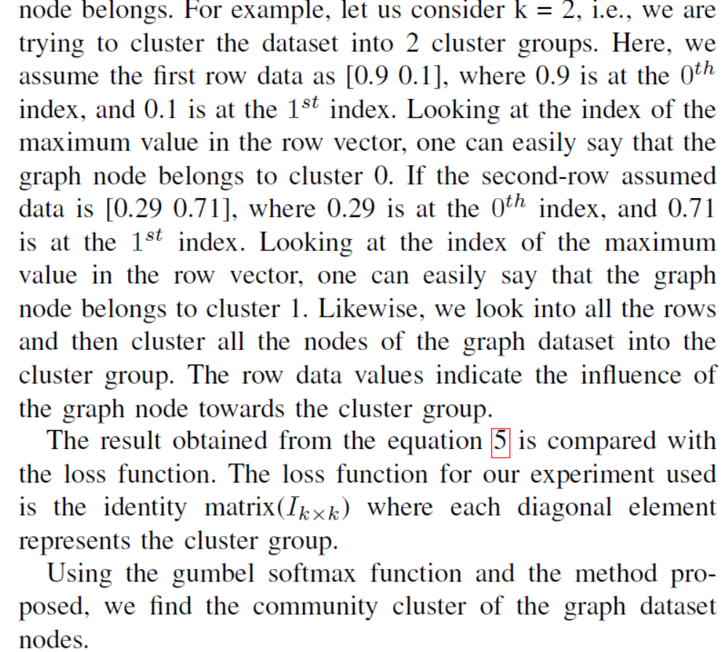

Slide 9
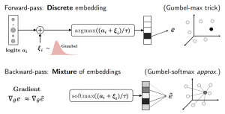
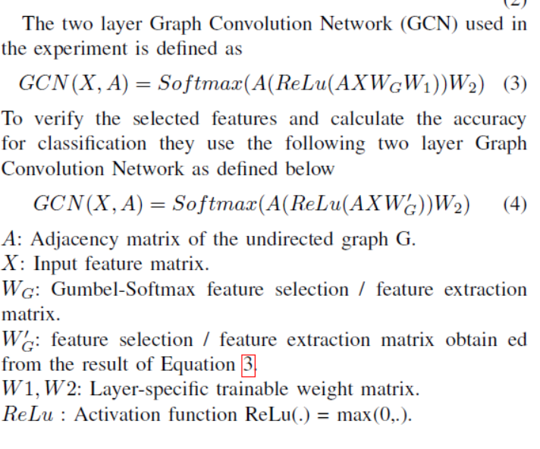
Gumbel Softmax clustering

Slide 10
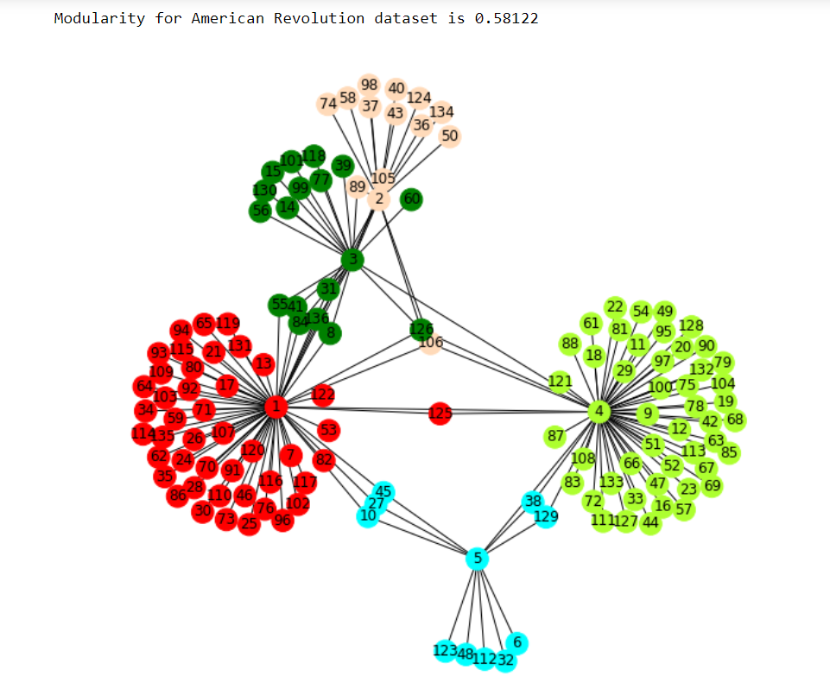
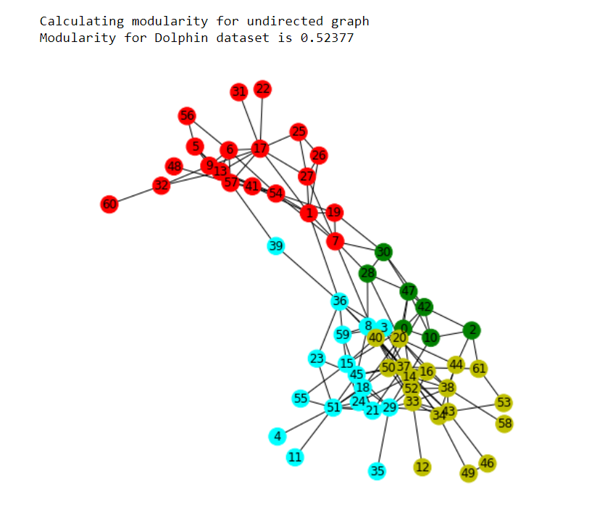
Clustering obtained using Gumbel softmax on different datasets

Slide 11
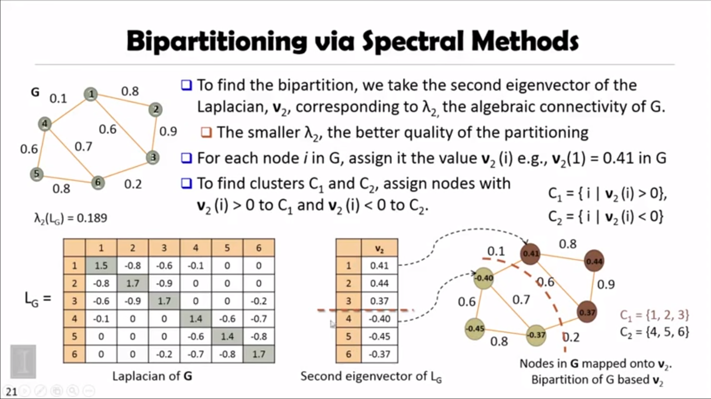
Spectral clustering Theory

Slide 12
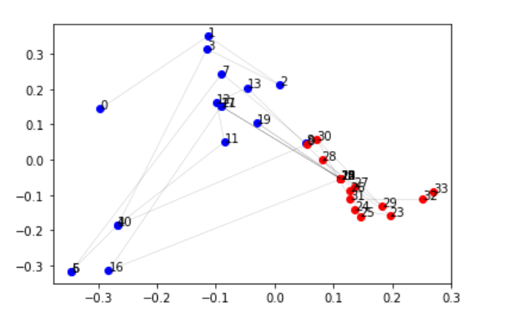
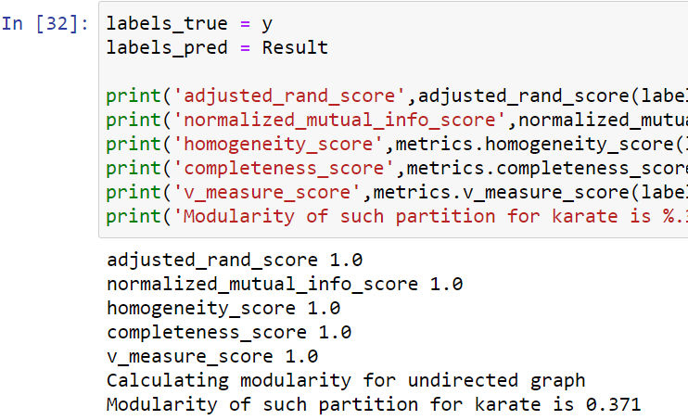
Comparison with Spectral Clustering

Slide 13
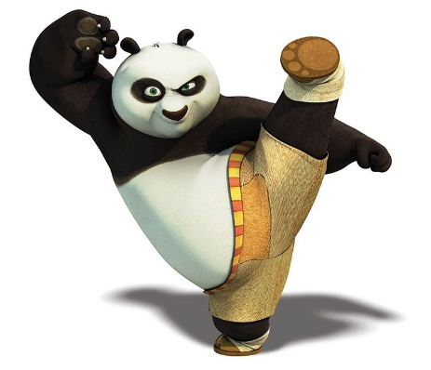
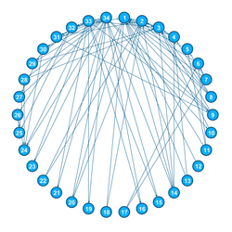
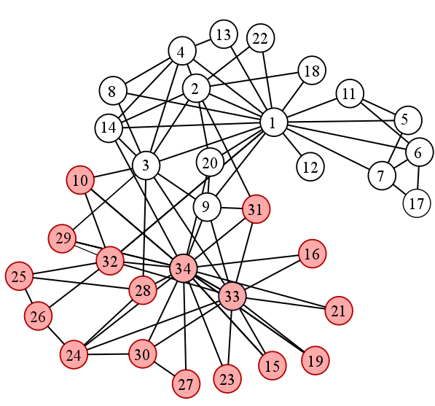
Zachery’s (Infamous) Karate Club

Slide 14
PLAN Ahead
Using the model on big graph datasets.
Make a brief report.

